Slide 1


00
Monocular Depth Estimation
Indoor dataset
Rahul Nair

Slide 2
Challenges in Depth estimation for the indoor environment?
01
Weaker structure priors - cluttered objects arranged arbitrarily in the near field
Uneven depth distribution
Camera pose - 6DoF
Untextured surfaces
Reflective surfaces
[4]

Slide 3
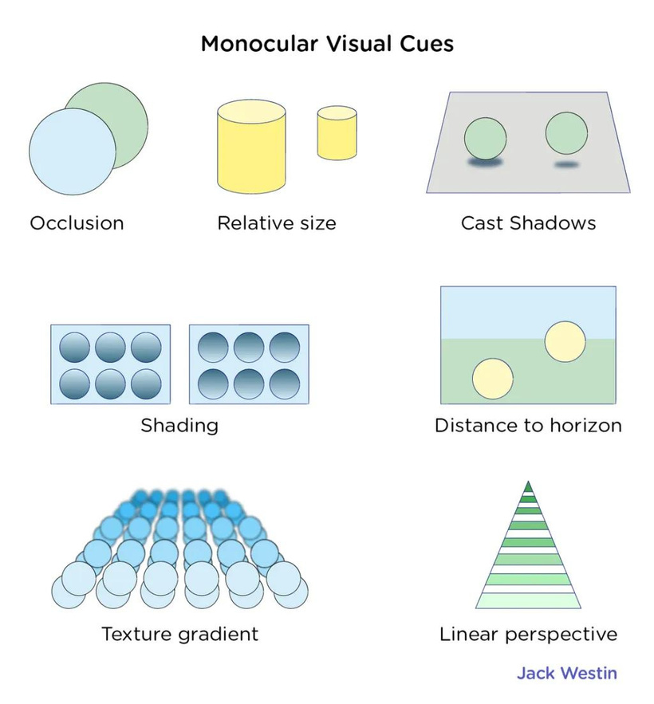
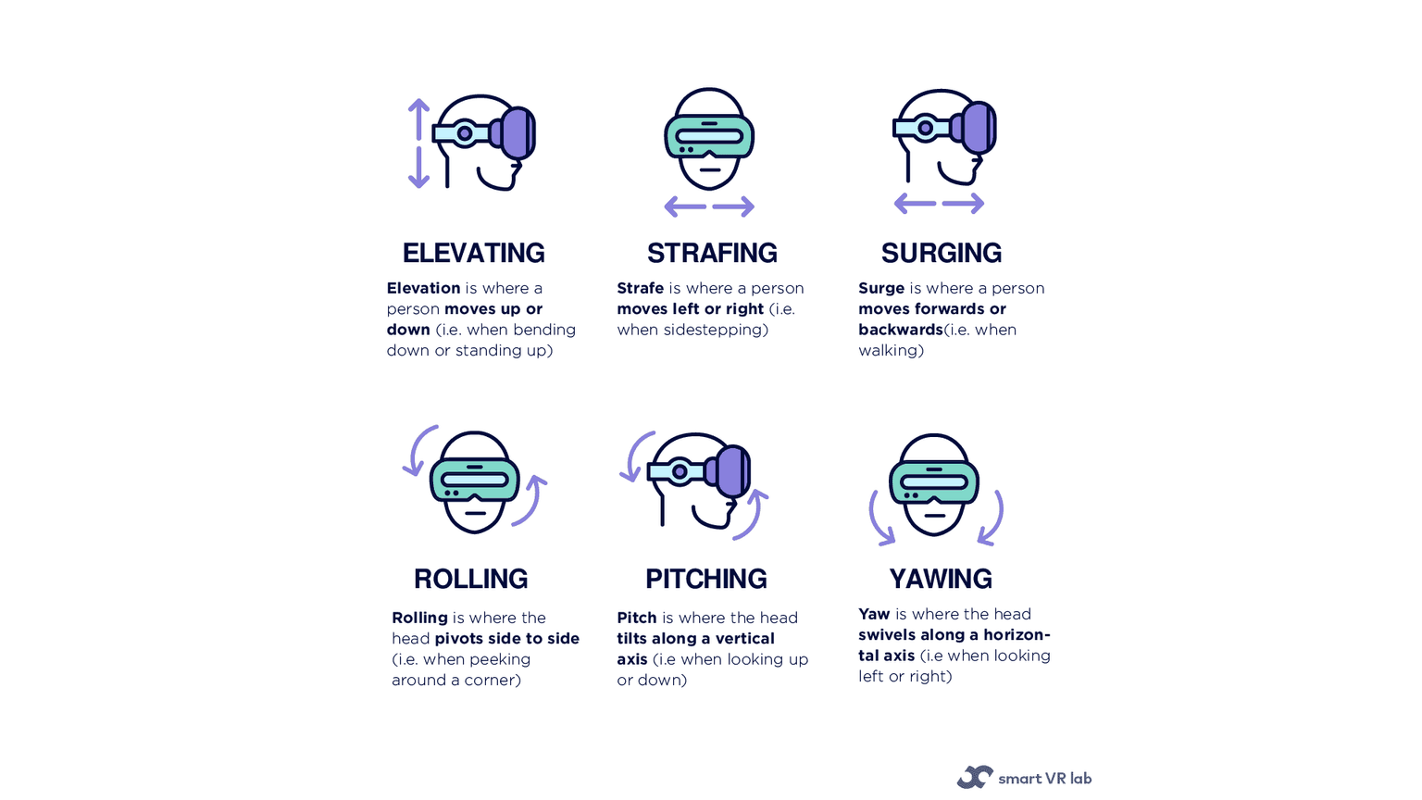
02
CHALLENGES CONTINUED
[1]
[5]

Slide 4
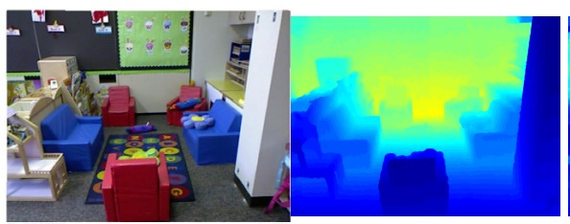
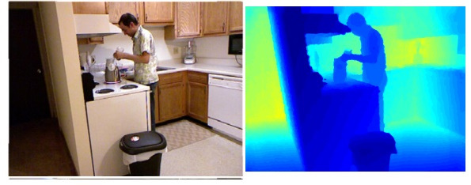
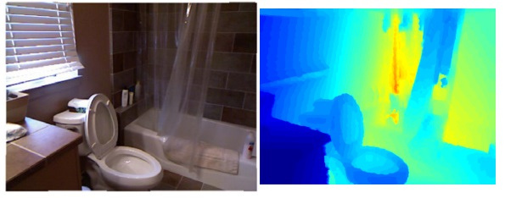
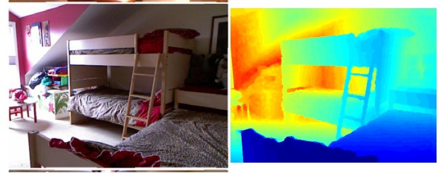
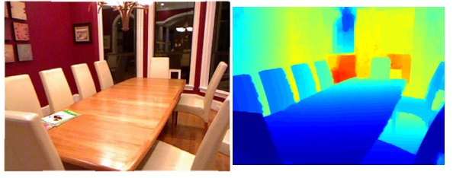
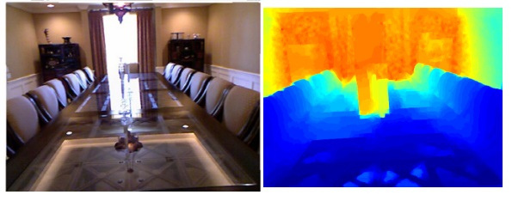
INDOOR EXAMPLES
03
[4]

Slide 5
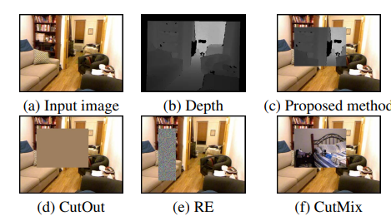
RELATED WORK
04
Here we look at three different recent works to help understand the problem of monocular depth estimation for indoor environments, the challenges and approaches to the problem statement.
CutDepth:Edge-aware Data Augmentation in Depth Estimation
High Quality Monocular Depth Estimation via Transfer Learning
Toward Practical Monocular Indoor Depth Estimation
They proposed a simple transfer learning-based network architecture. The resulting depth maps capture object boundaries more faithfully with fewer parameters and fewer training iterations. They used transfer learning, repurposed with high performing pre-trained networks, designed for image classification as the encoder. Future advances in one domain are easily transferred to the depth estimation problem. Such encoders tend to produce sharper depth estimations with the presence of skip connections.
This work proposed a practical indoor depth estimation framework that has the following features: learning from off-the-shelf estimators and left-right image pairs without their depth annotations, efficient training data collection, high generalizability to cross-dataset inference, and accurate and real-time depth sensing. Their work applies to consumer-level AR/VR, such as 3D indoor scene reconstruction and virtual object insertion and interaction with environment.

Slide 6
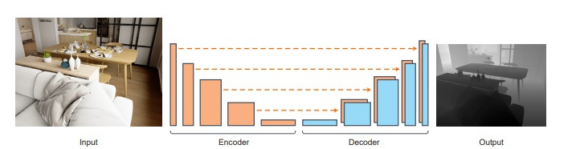
ENCODER-DECODER WITH SKIP CONNECTIONS
05
[3]
Encoder-Decoder architecture: the Encoder will convert the input sequence into a single-dimensional vector (hidden vector). The decoder will convert the hidden vector into the output sequence.
Skip connections: a type of shortcut that connects the output of one layer to the input of another layer that is not adjacent to it.

Slide 7


06
Progress W23Y2023
Tasks Done:
Explore challenges for depth estimation in indoor environment/dataset
Come up with examples of indoor depth estimation
Read related recent works
Tasks ToDo:
Analyze indoor dataset
Review existing implementations
Read further into more recent works on the topic of monocular depth estimation
Issues:
None so far

Slide 8
07
REFERENCES
[1] Bogdanova, R., Boulanger, P., & Zheng, B. (2016). Depth Perception of Surgeons in Minimally Invasive Surgery. Surgical Innovation. https://doi.org/10.1177/1553350616639141
[2] Ishii, Y., & Yamashita, T. (2021). CutDepth:Edge-aware Data Augmentation in Depth Estimation. ArXiv. /abs/2107.07684
[3] Alhashim, I., & Wonka, P. (2018). High Quality Monocular Depth Estimation via Transfer Learning. ArXiv. /abs/1812.11941
[4] Wu, C., Wang, J., Hall, M., Neumann, U., & Su, S. (2021). Toward Practical Monocular Indoor Depth Estimation. ArXiv. /abs/2112.02306
[5] Unkown (2021). What is the difference between 3DoF vs 6DoF in VR? The comprehensive guide to Degrees of Freedom

Slide 9
Thank you!

